Slide 1
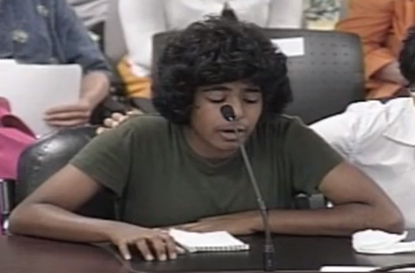
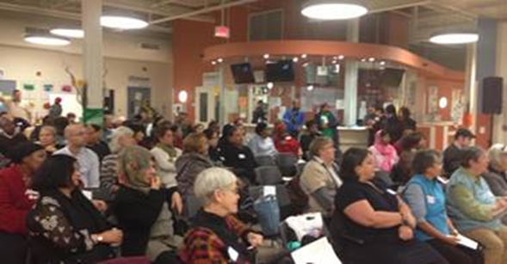
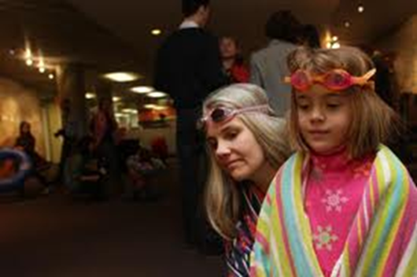
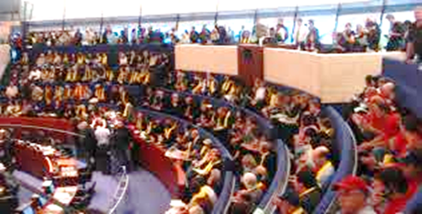
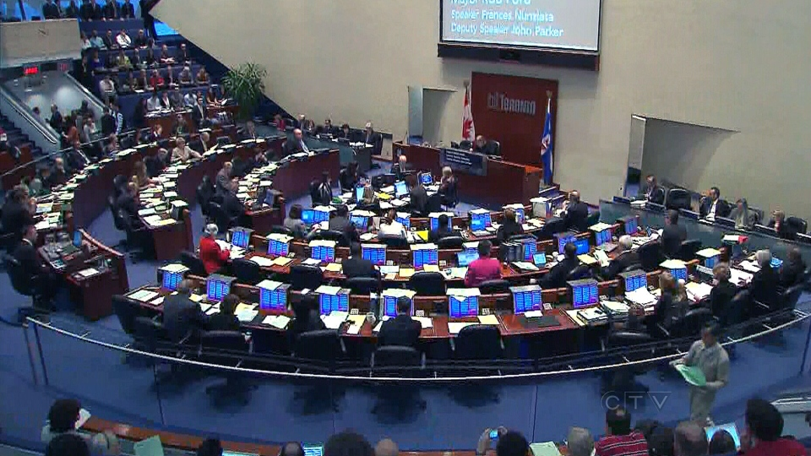
2017 City Budget
Monday, October 17, 2016
Middle Childhood Matters Coalition Toronto
Notes:
Today, I am going to talk about the City of Toronto budget, why it matters for communities, how the process works, what we know so far about the 2017 city budget, and most importantly, how you can get involved.
The City of Toronto budget is arguably the most important set of decisions that Toronto City Council makes each year. Council makes decisions about what services will be a priority and which ones will be cut. Each year, thousands of residents and sometimes tens of thousands get involved in the budget process because they know how these decisions affect them, their families and their communities.

Slide 2
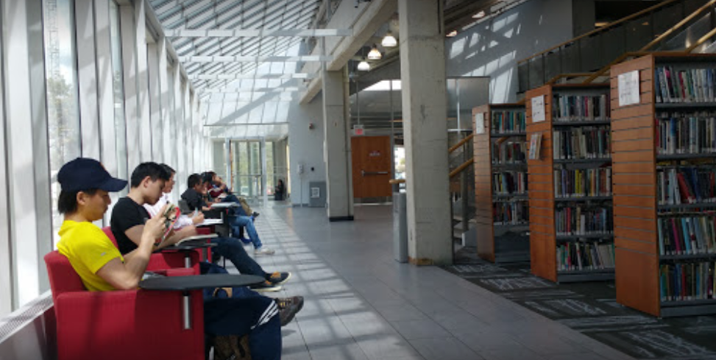
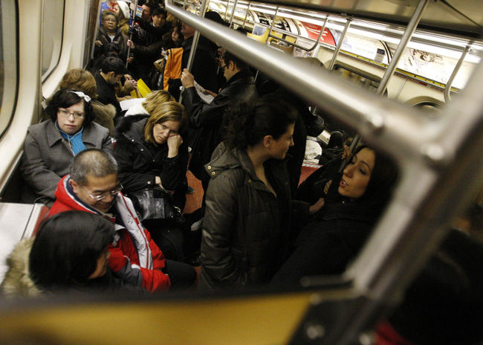
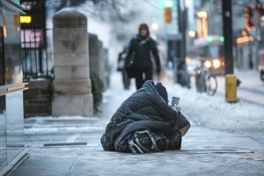
Why the City Budget Matters
City services shape the quality of life of Toronto residents
Notes:
Why does the City budget matter? It’s the place where Toronto City Council decides the priorities for the city, whether its investments or cutbacks in library services or recreation programs, whether Council is going to make your daily transit commute any better or not; they make decisions about what kind of city we want to be, do we want to be a fair and compassionate city where we provide the supports for people who are struggling, and do we invest in the programs that safeguard lives, and get to the heart of the problem to address ongoing crises in our city, like the crisis of homelessness.

Slide 3
Notes:
This graph shows where the city’s operating budget money comes from based on the 2016 city budget. It was a 10 billion budget, and as you can see 39% comes from property taxes, so property taxes are a large portion of the funding but it’s not all paid for by property taxes. Then provincial grants and subsidies at 19%. This provincial funding pays for many cost-shared programs in public health and social services. Both the province and City of Toronto contribute to the funding of these services. Then we’ve got 12% of revenues coming from the TTC farebox. The rest are small bits and pieces from other sources but all are important. The Municipal Land Transfer Tax from the sale of homes at 5% of revenues is a small but indispensable amount. We would have seen a great deal of cuts if the city hadn’t instituted and maintained the MLTT. One problem with the MLTT is that the amount we raise depends on the real estate market. We have had many years of hot markets but when things soften, we won’t bring in as much from MLTT. Our over-reliance on the MLTT is another reason why we do need additional revenue tools to fund our city services.

Slide 4
Budget Process & Key Dates
Summer 2016:
Mayor and City Council set direction for budget (public)
City staff develop the budget (behind the scene)
December 1: Executive Committee meets to discuss long-term fiscal plan (revenue tools) Public can make deputations (short presentation) to the committee.
December 2: Public launch of the staff recommended (draft) budget
Mid-December: SPT to host city budget forums
December-February: City Councillors hold budget town halls for community members
December 16, 19, 20, 21: Budget Committee reviews the budget
January 5, 9, 10: Members of the public make presentations (deputations) to the Budget Committee
January 12, 24: Budget Committee makes its budget recommendations
February 7: Executive Committee reviews the budget, makes its recommendations
February 15 & 16: Toronto City Council makes final decisions about the budget
Notes:
Now I’d like to walk you through the budget process and talk about some key dates and opportunities for participating. In the Summer, the mayor and city council voted on setting some directions for the budget and I’ll talk about those directions in a moment. Then the City staff took those directions and behind the scenes started working on their budgets.
On December 1 the Mayor’s executive committee meets to talk about the long-term fiscal plan and options for how to pay for city assets and services; they’ll talk about revenue tools and possible asset sales as well. People can sign up to speak to the committee on that issue. They will have deputations.
Then on December 2 the staff recommended draft budget is launched. In mid-December, Social Planning Toronto will host 4 budget forums to help the community understand what’s in the staff recommended draft budget and how they can get involved in the budget process. Between December and February, many councillors will host budget town halls which is a great way to find out more and give your input directly to the councillor. In late December, the budget committee begins its review of the budget. Then on January 5, 9 and 10 the budget committee will have deputations where members of the community can provide their input directly to the budget committee. On January 12 and 24, the budget committee will finish its work, making recommendations for the 2017 city budget. The budget then goes to the Mayor’s executive committee to review and make its own recommendations. Finally on February 15 and 16, the budget is voted on by all of city council and these are the final decisions.
Throughout the budget process, there are opportunities to speak, to ask question, to have your voice heard. We have seen that when communities come together they can have an important impact. Five years ago, we saw tens of millions of services saved because community members didn’t like what they saw in the budget, and council heard very strongly people’s positions. In the end, many services were saved, and it would not have happened if the community had not have gotten involved.

Slide 5
City Plans & Strategies
• Housing Opportunities Toronto: An Affordable Housing Action Plan, 2010-2020 • Housing Stability Service Planning Framework • Infrastructure and Service Improvement Plan for the Emergency Shelter System • Mayor’s Task Force on Toronto Community Housing • George Street Revitalization
•TO Prosperity: Toronto Poverty Reduction Strategy
• Toronto Public Health Strategic Plan, 2015-2019: A Healthy City for All • TTC Improvements • SmartTrack • Rail Deck Park • Toronto Middle Childhood Strategy • Parks Plan 2013-2017 • Parks and Recreation Facility Master Plan • Toronto Children’s Services Service Plan: 2015-2019 • “Working as One” Workforce Development Strategy • Youth Employment Action Plan • Toronto Strong Neighbourhoods Strategy 2020 • Social Development Strategy • Seniors Strategy • Newcomers Strategy • Youth Equity Strategy
Notes:
I want to provide a bit of context for thinking about the city budget. Toronto City Council is great at creating city plans and strategies to make our city a better place, to make it more equitable and inclusive and to meet the needs of a variety of groups. They are very good at making plans. But I would say those plans don’t mean much if they aren’t funded. Most plans require new investment to implement them. If you want to reduce poverty, or improve transit, or make housing more affordable, it’s going to cost money. So keep this in mind as I turn to the next slides.

Slide 6
Fairness Gap Widens
Over the past 6 six years:
Property taxes decreased by 5%
$60 vehicle registration tax eliminated while TTC fares increased by more than 18%
User fees increased by 9%
8.9% cut to services
Notes:
How has the city been doing over the past six years? Factoring in inflation, property taxes have actually decreased by 5% which means lost revenues to pay for important services; the $60 vehicle registration tax was introduced and then eliminated while at the same time TTC fares increased by over 18%; user fees went up by 9% and services were cut by almost 9%; Council decisions have led to a widening of the fairness gap in our city.

Slide 7
Budget News
City Council voted to direct City staff to:
Cut their budgets by 2.6% below the 2016 approved budget
Keep residential property taxes at or below inflation
Find “efficiencies”
Maximize user fee revenue up to full cost recovery
Pay for any new or enhanced services within existing budgets
It’s more than a 2.6% cut – budgets also have to cover the increased cost of services due to inflation
Notes:
What do we know about the 2017 city budget so far? In the summer, City Council voted on several motions, providing direction to City staff on how to develop the 2017 city budget. Their directions were to cut all divisional and agency budgets by 2.6% below the 2016 approved budget; to keep residential property taxes at or below inflation. (It’s important to know that any increase to property taxes, the increase for business is less than the increase for residents, so the overall property tax rate is actually below inflation when residential property taxes are increased at or below inflation.) Next the staff were directed to find efficiencies as they are in every budget. Then they were told to maximize user fee revenue even to the point of full cost recovery. That means that user fees would pay for the full cost of delivering the service. So consider for instance recreation user fees and what the impact that would have if those fees were increased dramatically. Next they were told if you want something new or expanded use your exisiting budgets, it would be good if you did not require additional money to do it. Work within your existing budget or cut something else to pay for it.
I want to say first that a 2.6% cut is a much bigger cut than it appears. Because these budgets have to also cover the increased costs of services due to inflation. They also have to cover any council directed services or service improvements. I’ll give you a couple of examples about how the cut is much bigger than 2.6%.

Slide 8
What do we know about the cuts so far?
Public Health - Medical Officer of Health identified options for reaching 2.6% cut – student nutrition programs – Board of Health voted against making this cut
TTC – a 2.6% cut = $15.9 million, but they already need an additional $190 million to maintain services and implement Council-directed service improvements
Increase fares, cut services = ridership loss and reduced revenue
Police – taskforce recommends $100 million cut over 3 years; budget request shows a $2 million reduction over the 2016 approved budget, 0.199% cut. An additional $24 million cut would be needed to meet the 2.6% reduction
Toronto Public Library - requesting an additional 0.9% above the 2016 approved budget
Toronto Community Housing – CEO says a 2.6% cut would force the city to close units, cancel service improvements for tenants recommended by mayor’s own taskforce
Worries about shelters and community grants
Watch for recreation user fee increases
Notes:
In terms of specific agency or divisional budgets, we’ll know far more on December 2 when the staff recommended draft budget is released. For now, -- in public health, the acting medical officer of health gave options for how the cut could be made. She said they could cut 44 student nutrition programs affecting over 13,000 children. The Board of Health met and voted against the cut to the 44 programs. So it remains to be seen how/if they will meet the 2.6% target.
The public health budget does include some good things – funding for the Toronto Urban Health Fund for its 3rd year of implementation. These funds go to nonprofits that deliver HIV/STI prevention, harm reduction and child resiliency programs. That’s in the budget, as well as some additional programs like immunization, water safety, and food inspection.
But what is NOT included is the investment for the fifth year of the Student Nutrition Program which would require $2.2 million to improve the program and expand funding to 44 school programs that do not currently receive municipal funding. The Council has a 6 year plan to increase funding for student nutrition and expand the program to new high-needs schools. So far, this money is not in the budget to implement the expansion in year 5.
Next TTC a 2.6% cut is $15.9 million but the ttc is already $190 million in the hole because of budget pressures. The most recent budget request from TTC said they are still looking for $172.6 million to cut or to bring in additional revenues. That is the equivalent of about 15% of the cash fare box. So a lot of money. In the summer, CEO Andy Byford said that they have been cutting and finding efficiencies in the TTC for years and that these cuts would be difficult to implement without affecting services. The Mayor responded that if the TTC can make the cuts, he’ll find someone who can – a consultant or task force.
On police – every year the police budget increases, last year to over $1 billion. Council set up a taskforce which came out with an interim report recommending $100 million in cuts over 3 years. However the budget proposal for 2017 includes a $2 million reduction. An additional $24 million cut would be needed to make the 2.6% cut.
Libraries – have had years of cuts to staffing and services. In this budget, they are requesting a 0.9% increase which is under inflation. One of the ways that they intend to increase revenues is by charging more to permit their meeting spaces, and also more for their leased space.
TCHC – already has a $96 million shortfall; their revenues are flatlined while their expenses are going up dramatically, 43% increase for hydro since 2012, and a 36% increase for water. A 2.6% cut would add another $5 million to the shortfall, adding up to $101 million. CEO Greg Spearn has said that he would have to close units to meet the budget direction and his shortfall. He also said that they could reverse the mayor’s own investments in tchc from his taskforce which were 5.4 million lsat year. When asked if tchc could be a good landlord and make these cuts, Greg Spearn said no they could not.
On the capital side, they still need senior orders of government to contribute to the 10-year capital plan to repair TCH tenant homes. They will try to restructure their debt once again which may free up $200 million more for capital repairs.
We don’t have specifics about the divisional budgets until they come out on December 2. However, we are hearing that budgets for shelters and community grants to nonprofits (CPIP) are at risk. Consider that the shelter system is already operating at capacity and the city is finally moving to open new shelters to begin to address the crisis. Community grants also serve the most marginalized; another action that would be in contradiction to the poverty reduction strategy. We are also worried about the potential for large recreation user fee increases. We’ll know more on December 2.

Slide 9
Some Councillors tried to change the motion to protect communities
Maximize user fee revenue only if it is consistent with the City’s Poverty Reduction Strategy
Avoid TTC fare increases above the rate of inflation
Avoid cuts to TTC bus, streetcar, Scarborough RT, subway routes
Avoid impacting the quality of life of TCHC tenants
Avoid the reduction of the 200 new child care spaces approved in 2016
Have a slightly higher property tax increase (3.4%) to reduce cuts to services
BUT … a majority of City Council voted against these protections
Notes:
I want to tell you that some Councillors fought the good fight and tried to pass a number of motions that would protect communities from these service cuts. They moved motions to maximize user fee revenue only if it is consistent with the City’s poverty reduction strategy, meaning only if low income residents would not be hurt by the increase; they wanted to avoid ttc fare increase about the rate of inflation, avoid cuts to ttc service, avoid negatively affecting tchc residents, avoid cutting the 200 new child care spaces that they just approved this year. All of those motions failed. A majority of Council including the Mayor voted against all of those motions. We have a voting record that show some of those key votes and who vote for what.

Slide 10
What could the cuts mean?
It will take some time to get the full story on what the cuts mean for communities. We will know more on December 2 when the draft budget is released, and we will learn more as the budget process advances.
City recreation programs focus on children and youth, newcomers, seniors, low income residents and members of marginalized groups.
What could cuts to recreation and children services mean for our communities?
For people using city recreation services
it could mean higher recreation user fees that put recreation out of reach for individuals and families
it could mean fewer recreation programs, or centres that close early or aren’t open as often
it could mean fewer staff to provide programs and services
It could mean programs that are free now might start charging a fee
It could mean fees for play fields could go up again, making it difficult for people to afford to play
Notes:
This slide provides an example of what service cuts could mean … in this example for recreation users. We don’t know what recommendations will be included in the budget and won’t know until Dec 2. These are some of the possibilities – higher user fees, decreased recreation services.

Slide 11
Another Budget is Possible
Source: Canadian Centre for Policy Alternatives, 2015
Notes:
So that was a lot of bad news. The good news is that we could have a very different budget that supports strong public and community services, that moves us forward on the poverty reduction strategy and other important city plans and strategies. City staff and community organizations have looked at the revenue tools available to the city to pay for important programs and services. There are several possibilities. On December 1, that discussion will continue at the Mayor’s Executive Committee. Even with realistic property tax increases, we will need new revenues to deliver on the city’s plans and strategies for creating a better city.

Slide 12
Get Involved! Have Your Say!
Join with others!
Commitment to Community campaign
Contact: Susan Kwong, skwong@socialplanningtoronto.org (416) 351-0095 x212
Speak with your City Councillor
Attend your City Councillor’s budget town hall
Share your views with the Budget Committee –January 5, 9 & 10
Sign up for City Budget Watch to get up-to-date info on the budget and how you can participate
Contact: Beth Wilson beth@socialplanningtoronto.org (416) 351-0095 x257
Check out the City of Toronto’s 2017 Budget page www.toronto.ca/budget2017 (not live yet as of Sept 2016)
Notes:
There are lots of options to get involved. Call or email us, and stay informed on the budget.

